Slide 1
Pragya Sujitkumar
pragyasujitkumar922004@gmail.com
Ph. No: +91 9611553678
Manipal Institute of Technology, Manipal
Srikar Bharadwaj R
srikarbharadwaj000@gmail.com
Ph. No: +91 7259595751
Manipal Institute of Technology, Manipal
EV MASTER CLASS CAPSTONE PROJECT
Simulation of On-Board Charger for E-Bike Application

Slide 2
1
Assumptions
The Onboard Charger was designed based on parameters specific to an Electric Bike:
Input Voltage (Vin): 110-240V AC: Allows compatibility with a wide range of standard wall outlets.
Output Voltage (Vout): 48V DC: Designed to match typical eBike battery requirements.
Output Current (Iout): 5A: Provides stable current for safe and efficient battery charging.
Output Power: 240W: Delivers sufficient power for standard eBike battery sizes, balancing charging speed and safety.
Charging Efficiency: >90%: Ensures minimal power loss, reducing heat production and improving overall energy efficiency.

Slide 3
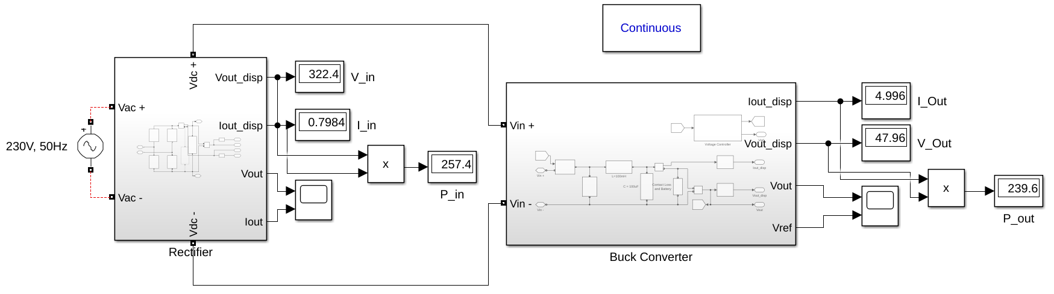
On-Board Charger Circuit
2
The onboard charger circuit was designed in MATLAB Simulink for ebike applications. It includes a Rectifier Block that converts the AC input (110-240V) to DC. This DC output is then fed into a Buck Converter, which steps down the voltage to a steady 48V, while ensuring efficient power conversion.
Fig. 1: Full Circuit of the On Board Charger

Slide 4
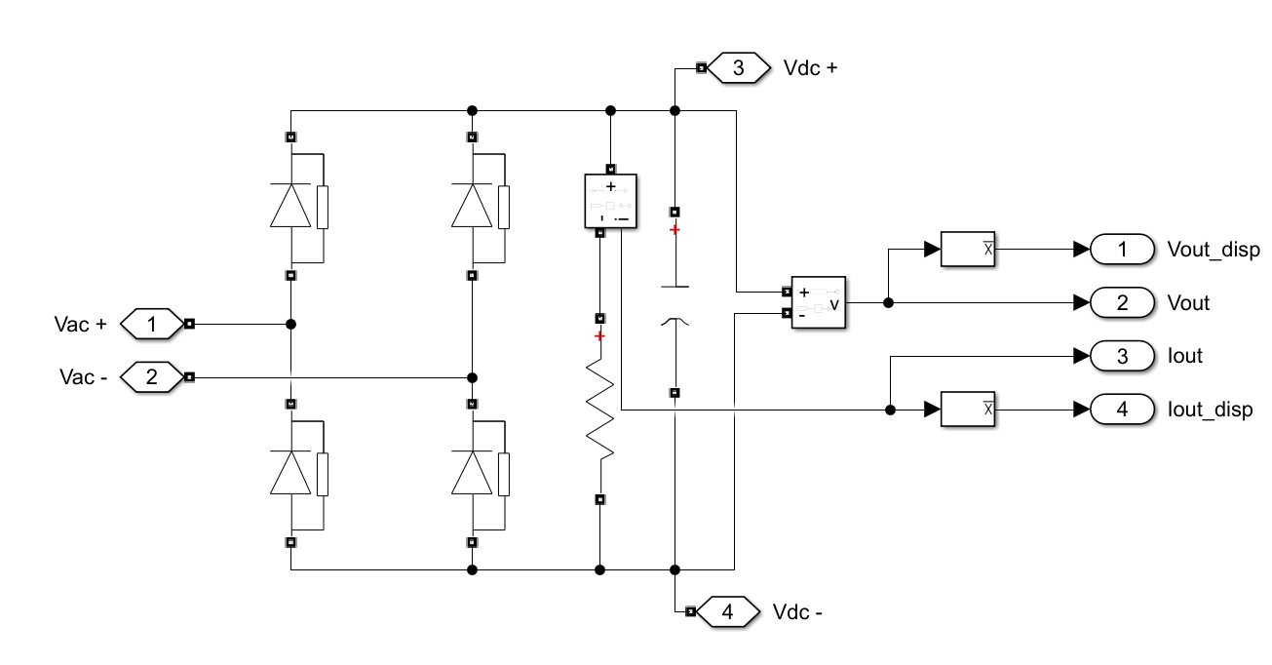
Single-Phase Full Bridge Diode Rectifier
3
The onboard charger uses a Single-Phase Full Bridge Diode Rectifier to convert AC input (110-240V) into DC output, forming the initial stage of the charging circuit. This rectifier design ensures efficient AC-DC conversion, providing a stable DC supply for subsequent voltage regulation by the Buck Converter.
Fig. 2: Full Bridge Rectifier with calculated filter capacitor

Slide 5
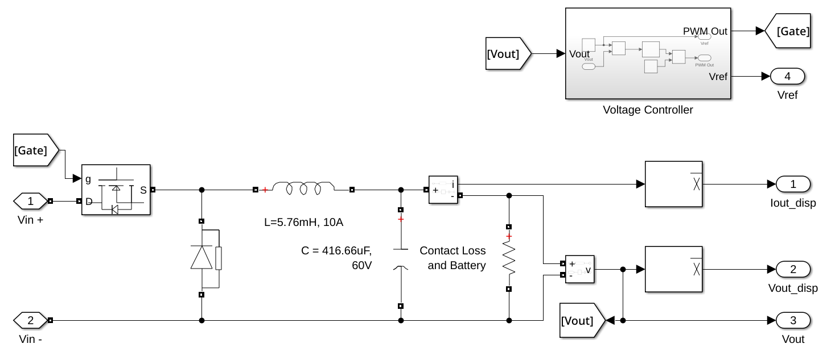
Buck Converter
4
The Buck Converter steps down a higher input voltage to a lower output voltage using a MOSFET switch controlled by a PWM signal, with key components including an inductor, capacitor, diode, and a voltage controller for stable output. The inductance and capacitance values are carefully selected to minimize ripple in current and voltage, ensuring efficient operation.
Fig. 3: Buck Converter with Voltage Feedback

Slide 6
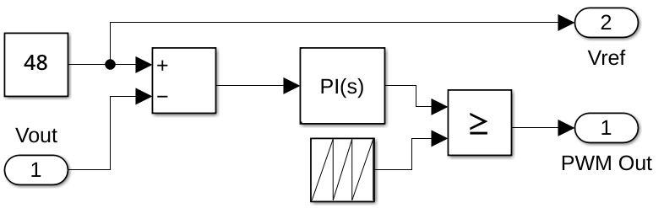
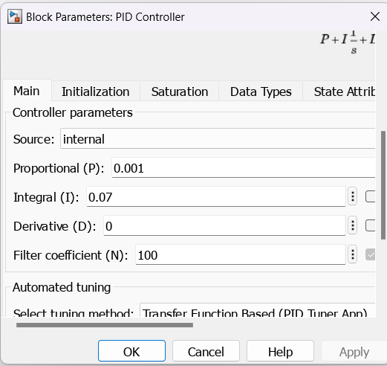
5
Varying Duty Cycle Ratio of PWM to gate of MOSFET
Output voltage is controllable by varying the duty ratio using PID control by providing reference voltage needed as per application (48V) and output voltage as feedback.
Fig. 4: PI Controller for setting the Duty Cycle
In this Buck Converter a PI controller is used, and its PI values are carefully tuned to have the acceptable voltage and current ripple and transients.
The P value was found out to be 0.001, and I was found out to be 0.07.
Fig. 5: PI Controller values

Slide 7
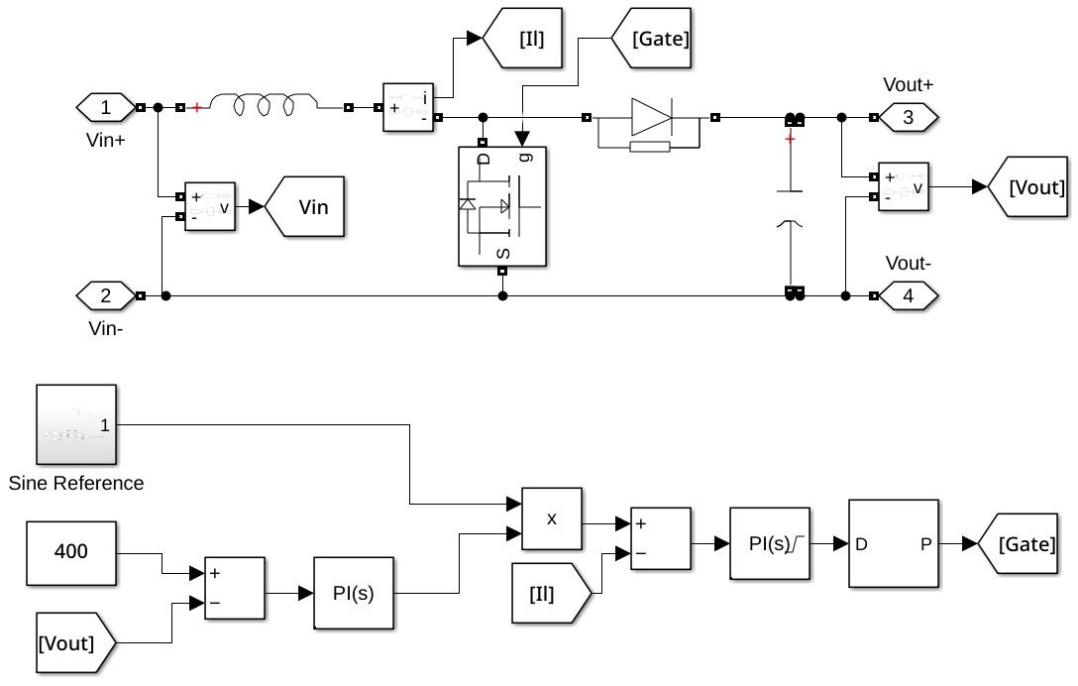
6
Boost Converter-Based Power Factor Correction (PFC)
Ensures sinusoidal, in-phase current draw from the grid, improving power factor and reducing harmonics.
Boost Converter:
Positioned after the FWR and before the buck converter.
Regulates input current to match a sinusoidal reference.
Sine Reference:
Sets the desired current waveform to ensure sinusoidal grid current.
PI Controller:
1. Outer PID (Voltage Loop): Controls the output voltage of the boost converter, keeping it stable by adjusting the reference current for the inner loop.
2. Inner PID (Current Loop): Regulates the input current to follow a sinusoidal reference in phase with the grid voltage, achieving power factor correction.
The circuit improves power quality by aligning current with grid voltage (enhancing power factor), reducing harmonic distortion, and increasing efficiency for grid-connected charging.
Fig. 6: PFC

Slide 8
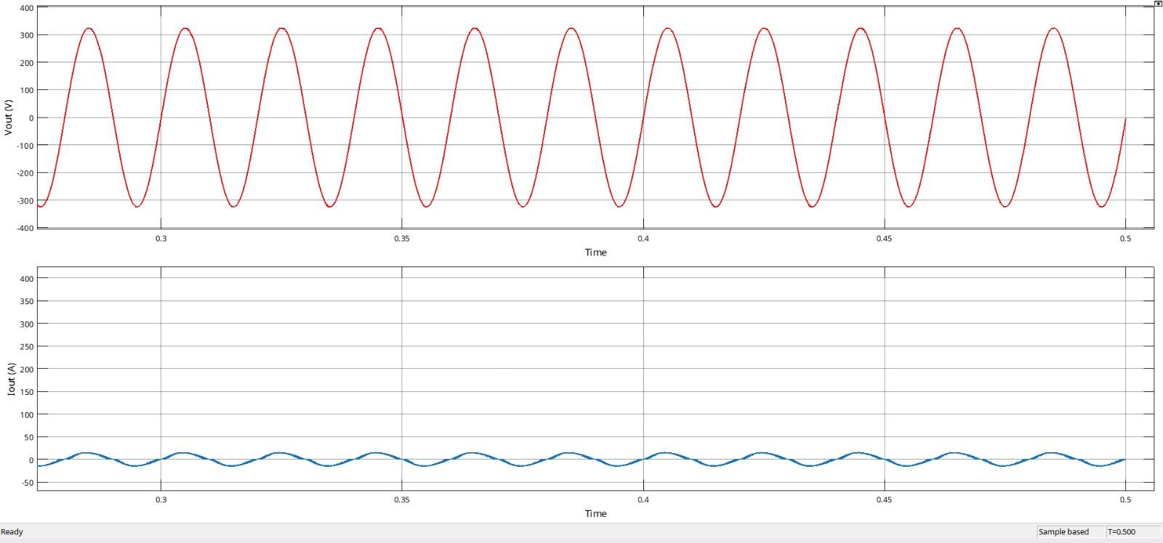
7
230V AC Input Scope
The circuit makes the input current from the grid sinusoidal by using two PI controllers that adjust the duty cycle of the boost converter. The outer PI controller regulates the boost converter’s output voltage by adjusting the reference current, while the inner PI controller controls the duty cycle to ensure the input current follows the sinusoidal reference waveform, keeping it in phase with the grid voltage. This synchronization of current and voltage results in a sinusoidal current draw.
Fig. 7: 230V AC Input (PFC)

Slide 9
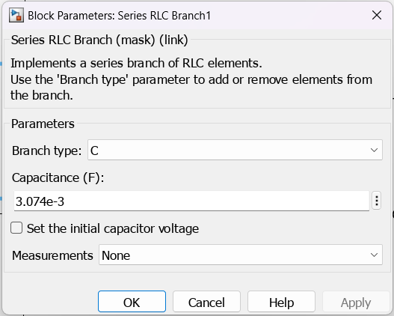
Output Voltage with 1% ripple and Current of 1A
8
Capacitor to be connected for a load (Resistive) current of 1A, ripple voltage of 1%.
= 1A/(2*50*230*sqrt(2)*1%
C= 3.074mF
Fig. 8: FBR filter Capacitance Value

Slide 10
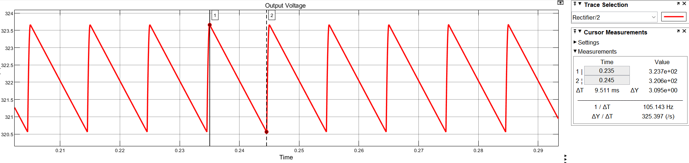
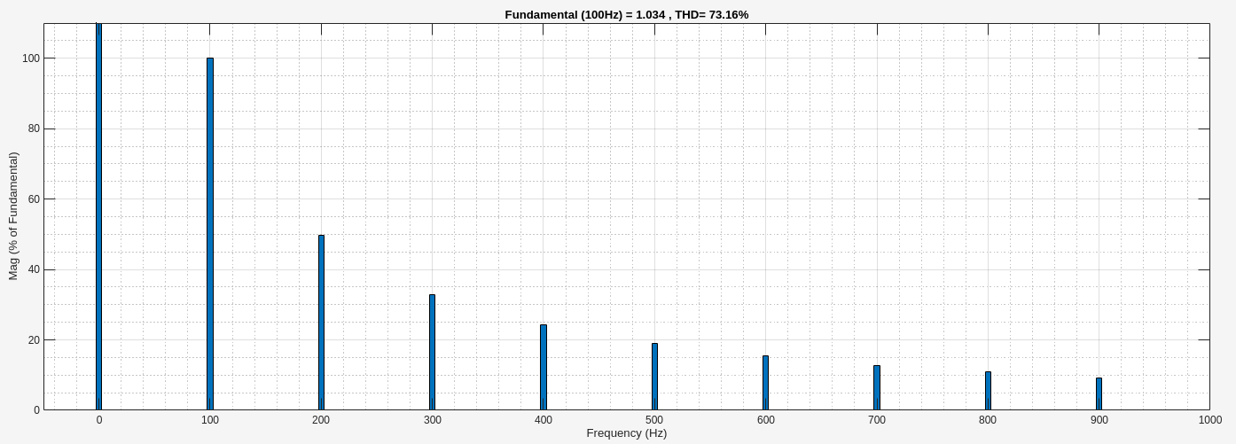
9
Output Voltage with 1% ripple and Current of 1A
With the calculated value of capacitance, the TDH was observed to be 73.18%, and the voltage ripple was around 3.01V which is <1%

Slide 11
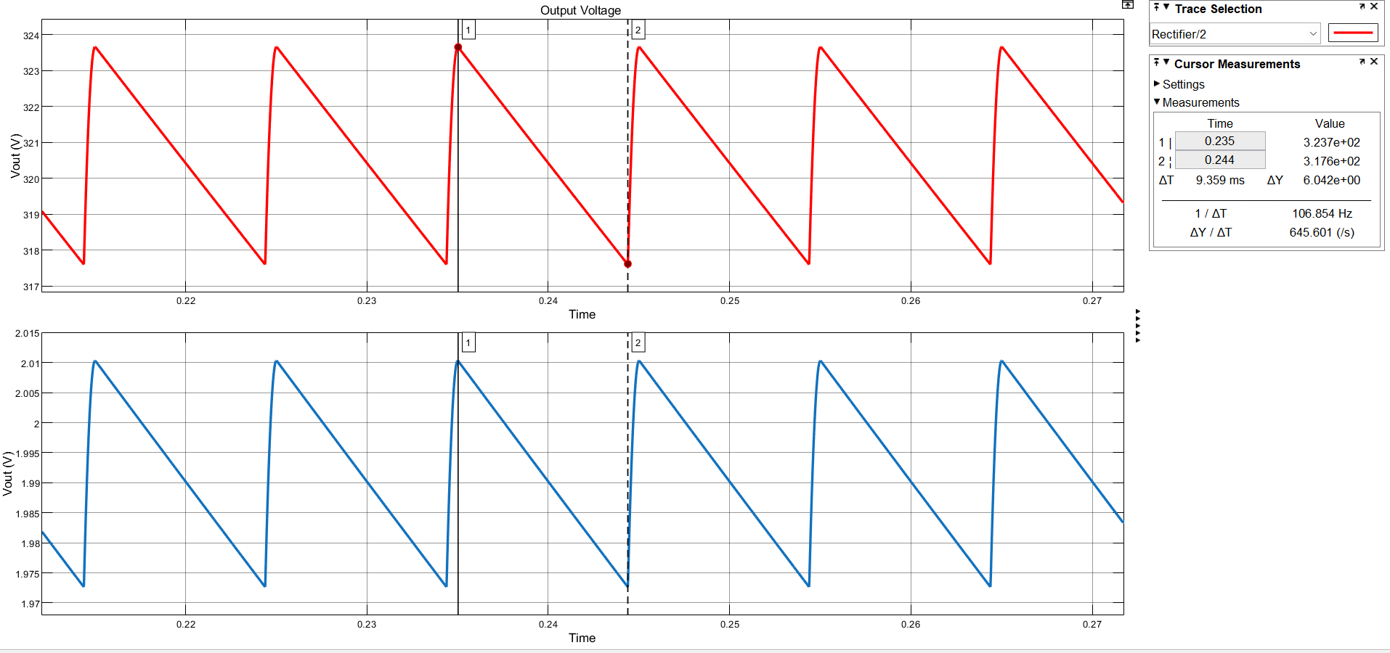
10
Output Voltage and Current of 2A by varying load
Vout (V)
Iout (A)
Fig. 9

Slide 12
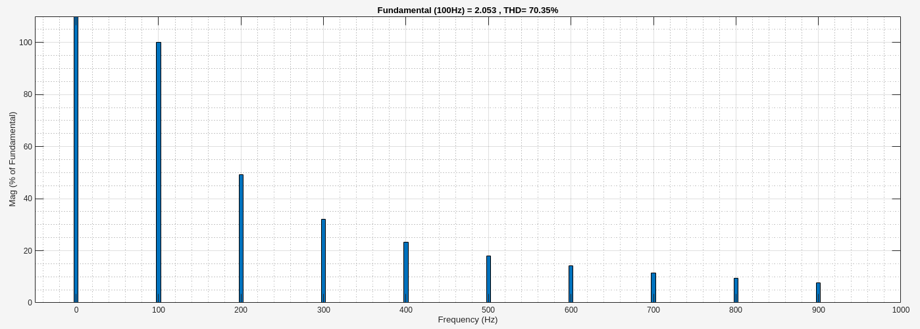
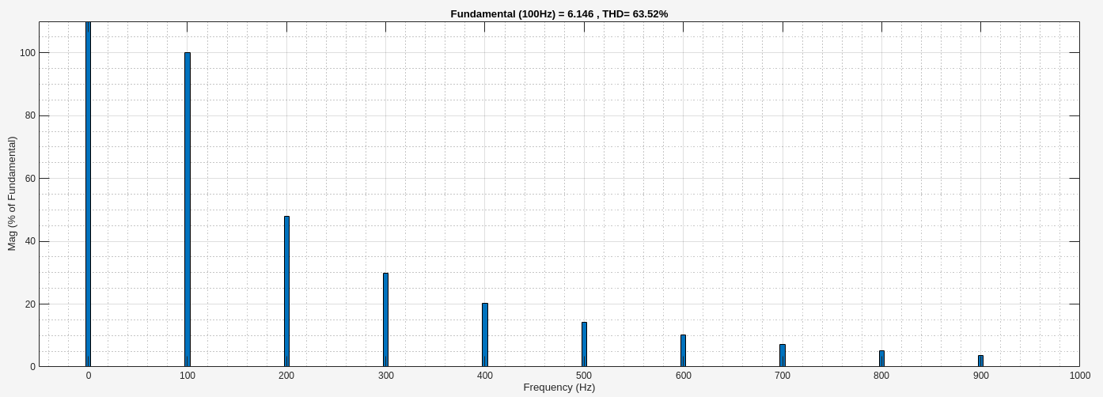
THD: Output Voltage with 1% ripple and Current of 2A
11
With the calculated value of capacitance, the TDH was observed to be 70.35%, and the voltage ripple was around 6.02V which is >1%.
To get the output voltage ripple <1%, the filter capacitor was change to 5mF and then simulated, which yielded 3.036V which <1% voltage ripple with TDH = 63.52.
Fig. 9

Slide 13
12
Output Voltage and Current of 2A by varying load
In Fig. 8, the ripple shown is 6.042V which is above the allowable limit.
As load resistance is halved by keeping same C and L values to draw 2A current rather than 1A, the ripple voltage increases due to a reasonable increase in current demand.
Reason:
Since the load resistance is decreased, the capacitor discharges very fast between the pulsating rectified voltage peaks. This fast discharging causes a bigger percentage to drop in the output voltage during the intervals between the peaks of the rectified voltage. Thus, it increases ripple voltage.
The increase in current draw causes the capacitor to deliver more charge in the same moment. The total capacitance unable to maintain a steady output voltage causes an increase in ripple voltage.
The capacitor which was functioning as an effective ripple suppressor at lower current might become ineffective at high current. Since to keep a ripple of less than 1% at 2A the capacitance should be increased.
Decreasing the voltage ripple also decreases the current harmonics, which reduces power loss and suppresses EMI.

Slide 14
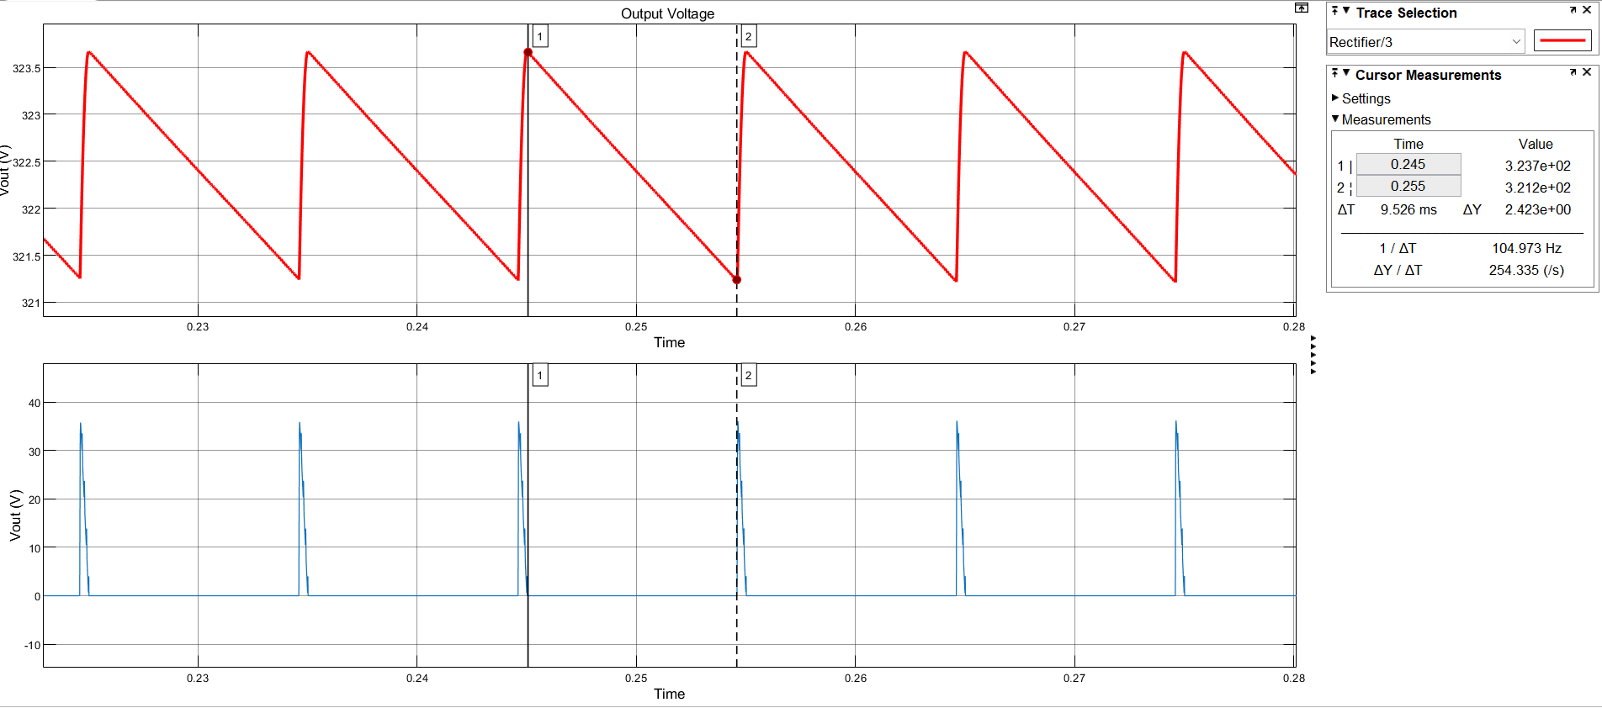
SCOPE: Output Voltage and Current of rectifier after connecting buck converter as load
13
Vout (V)
Iout (A)
Fig. 10

Slide 15
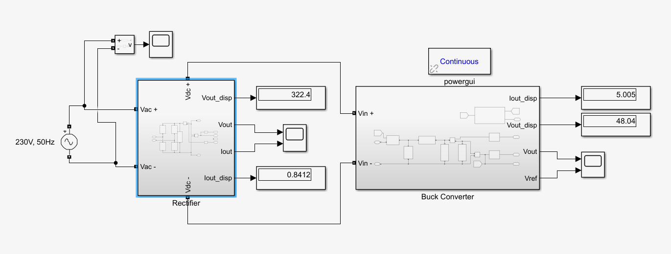
Output Voltage and Current of rectifier after connecting buck converter as load
14
In Fig. 9, the ripple shown is 2.423V which is within the allowable limit. The ripple is affected when a resistive load is replaced by a power converter like buck converter.
Reason:
When we vary the duty cycle of the buck converter, it changes the output voltage and indirectly impacts the input current drawn from the FWR. Higher duty cycles increase the output voltage, causing the converter to draw more current, which can influence ripple at the rectifier's output. But for this application we are keeping a constant voltage of 48V and supply of 5A by fixing the duty cycle.
The buck converter provides constant 5A output and smooths the output voltage, minimizing current variations and high-frequency switching noise, leading to reduced ripple at the rectifier compared to a varying load.
The constant power demand ((48V * 5A = 240W) from the buck converter stabilizes the current drawn from the rectifier, reducing fluctuation and ripple.
The PID-controlled duty cycle ensures consistent current and voltage output, helping to avoid ripple spikes at the rectifier.
Fig. 11: FBR with Buck Converter

Slide 16
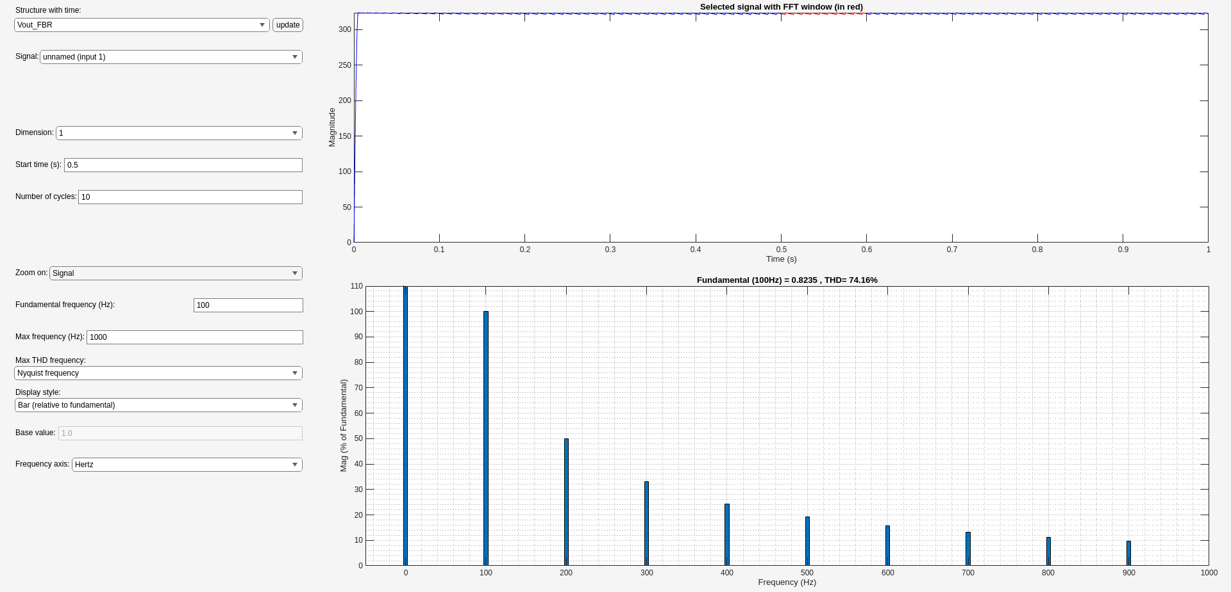
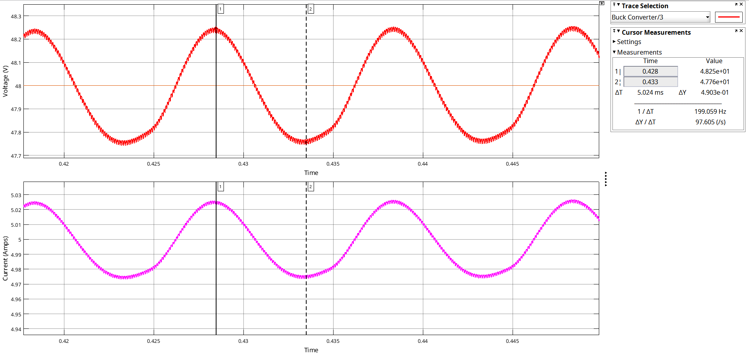
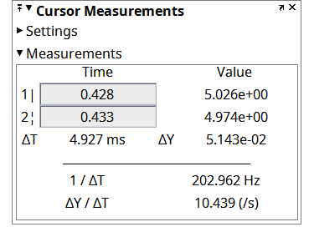
15
THD for FBR with Buck
The TDH of FBR with Buck Converter load was observed to be 74.16%.
The Buck converter’s output ripple was 0.51mA and voltage ripple was 0.49V, which were below the 1% limit.

Slide 17
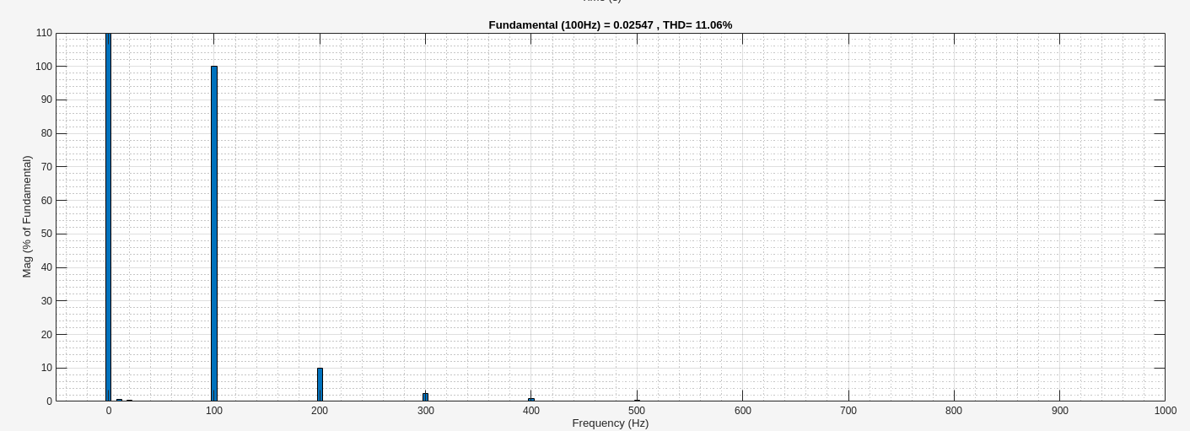
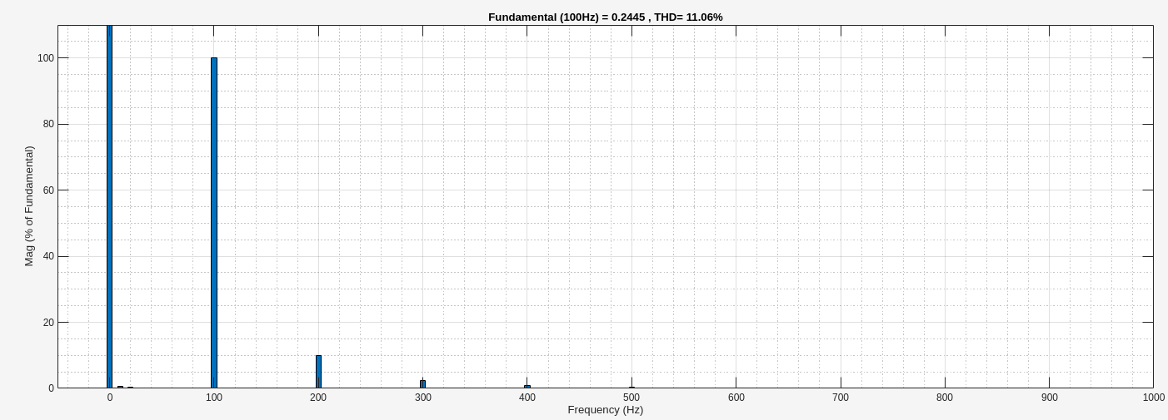
Buck Converter Output Characteristics
16
The TDH of the output current of the Buck Converter was 11.06%
The TDH of the output voltage of the Buck Converter was observed to be 11.06%

Slide 18
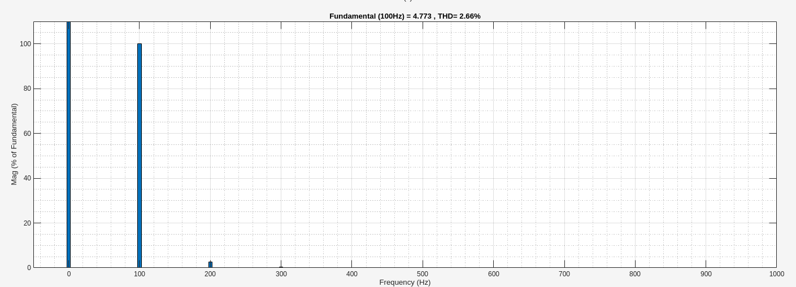
17
Conclusion
In this project, we successfully integrated a full-wave rectifier (FWR) with a buck converter to create a reliable and efficient 48V, 5A e-bike charger. By using a PID-controlled buck converter, the system achieves a stable output suitable for e-bike battery charging, while minimizing ripple at the rectifier's output. The constant current draw from the rectifier ensures reduced fluctuations and ripple, making the charger both efficient and well-suited for high-demand applications like e-bikes.
When the PFC circuit was added, the buck converter’s output voltage’s TDH dropped to 2.66%, which showed how important PFC is in a charger circuit.

Slide 19
18
References
[1] Erickson, R. W., & Maksimovic, D. (2007). Fundamentals of Power Electronics (2nd ed.). Springer.
[2] Texas Instruments. (n.d.). Battery Charger IC Data Sheets. Texas Instruments website.
[3] Mohan, N., Undeland, T. M., & Robbins, W. P. (2002). Power Electronics: Converters, Applications, and Design (3rd ed.). John Wiley & Sons.
[4] D. W. Hart, “Power Electronics,” McGraw-Hill Companies Inc., New York, 2010
[5] https://in.mathworks.com/discovery/power-factor-correction.html
Future Scope of this Project
Test other types of PFC methods (using SEPIC PFC, CUK PFC etc.)
Make the PI values adaptable to the load change.
Use of MOSFET for Full Bridge Rectification.
Use of other efficient techniques to bring down DC voltage.
Acknowledgement
We sincerely thank IEEE Kerala and BGSW for their invaluable guidance, support, and expertise. This project would not have been possible without their contributions and the resources provided.

Slide 20
Thank you

